Slide 1
e-learning Management system
Submitted By:
Rafi ahmed
ID:UG02-47-18-030
Batch:47th
Submitted To:
Khan Md .Hasib
Lecturer State University of Bangladesh

Slide 2
CONTENTS
Introduction
Home
About
Login
Study
Overview

Slide 3
INTRODUCTION
This project that helps school/university/college students for their study.
Two sides of users ,the admin side and the student side.

Slide 4
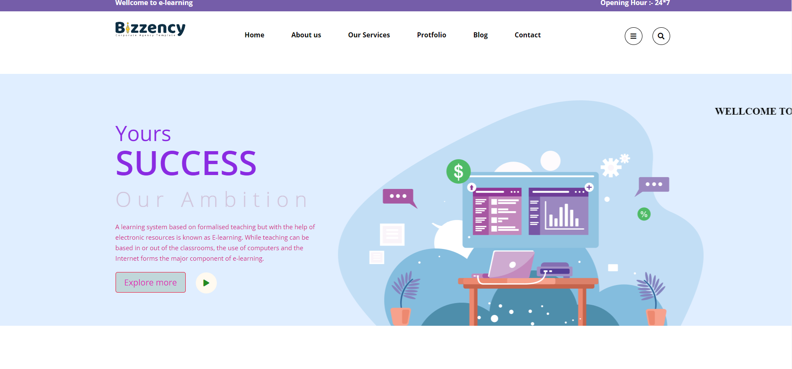
HOME
One can find all kind of information here.
This is the main part of this project.

Slide 5
Login
This is the log in sector where one can log in their account.
It has many parts like user photo , email etc.

Slide 6
Study
Here you can see all the information for study and book. If you want two read and take a cources.

Slide 7
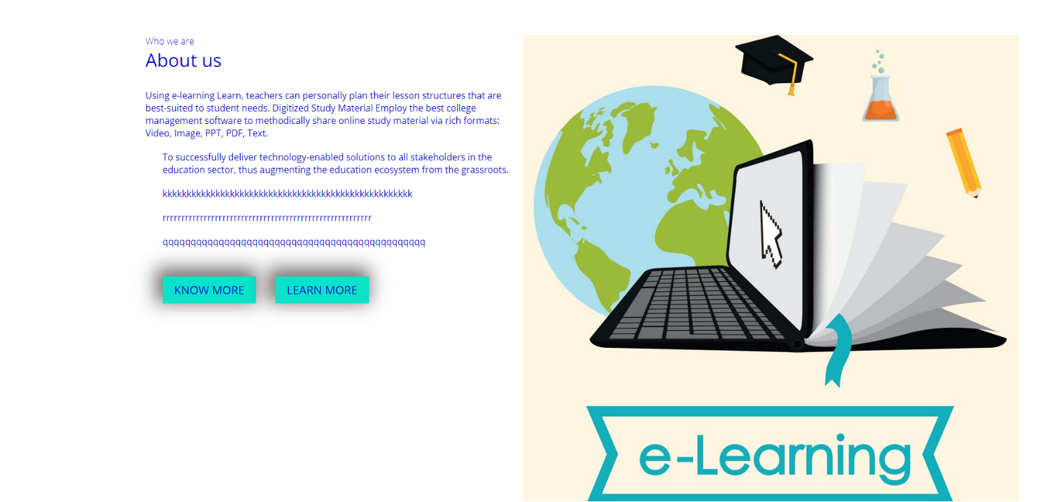
About
This is the part of the author information.
One can see all the information about the author

Slide 8
OVERVIEW
I hope the e-learning manajment System in PHP will help us with what we’re looking for and hope that we’ll learn something with this project that is useful for our future projects.

Slide 9
Thank you

